Slide 1
Kapture Technical Architecture

Slide 2
Kapture Components
Authoring
Knowledge Processing
Real-time Indexing
Rules
Knowledge Rendering
Semantic Search
Configuration
Metadata
Administration
Data Crawler
Integrations
Workflow
Content Mgmt.
Ranking
Deep Search
Dictionary
User Onboarding
Roles & Privileges
External Crawl
Concepts
Indexing Process
Synonyms
Knowledge Creation

Slide 3








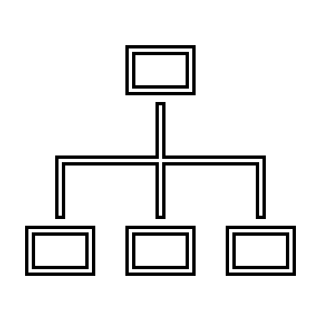

Logical Interaction of Kapture Components
Workflow
Authors
Authoring
Kapture DB
Metadata
Client Data
Real-time indexing
Data Processing
Knowledge Repository
Analytics
Integrations
User Onboarding
Knowledge Discovery
External Crawl
Synonyms
Roles & Privileges
Query
Boosting Rules
Search relevant information for query Intent, Entity, etc.,
User
Security (Visibility)
Results as response
Enterprise Search Engine
User Administration

Slide 4
Enterprise Search Request Processing
Step 1 - User Interaction
Users interact with the search system through a UI.
They input their search queries and provide additional parameters.
Step 2 - Query Parsing
The search system parses the user's query.
It breaks down the query into tokens, identifies keywords, and applies language-specific processing.
Step 3 - Query Understanding
Advanced processing techniques are applied to understand the user's intent and context.
This involves entity recognition, sentiment analysis, and intent classification.
Step 4 - Query Execution
Based on the parsed query and user intent, Search engine executes the search against the indexed data.
It retrieves relevant documents using advanced search algorithms.
Step 5 - Ranking and Relevance Scoring
Search results are ranked based on their relevance to the user's query.
Relevance scoring algorithms consider factors such as keyword frequency and document popularity, boosting rules and synonyms.
Step 6 - Filtering and Faceting
Users can apply filters and facets to refine search results.
This enables users to drill down into specific subsets of search results.

Slide 5
Enterprise Search Flow
Valid Query
Knowledge Processing
No
Invalid Query Message
Notify Author with feedback
Analytics and Monitoring
End
Yes
Yes
Feedback Collected?
Personalization and Recommendations
Query Understanding
User
Pagination/Infinite Scrolling
Index Available?
No
Error Message
Yes
More Results?
End of Results Message
No
Yes
Results Found?
Query Execution
Yes
Ranking and Relevance Scoring
Apply Boosting Rules
Filtering and Faceting
Presentation Layer
No
No Results Message

Slide 6



Kapture – High Level Architecture
kAuthoring
Content Authoring Application
kDictionary
Dictionary Tuning Application
kAdmin
User Management Application
kSearch
OOB Widgets
Web Interface
Security Layer - Single Sign On, HTTPS, Firewall etc.
3rd Party Integrations
API Layer
Content Authoring & Workflow
Content Search
Real-Time Data Analytics & Visualization Engine
User Management & Security
External Interfaces
Billing
LDAP
Database Layer/ File Server / Repository
Auto Translation
Salesforce Connector
File Server
External Content Crawling
Kapture KM Apps Database

Slide 7
Authoring Overview
A KM platform is an essential tool that empowers organizations to create and share information effectively. One of the critical features of such platforms is content authoring, which allows organizations to create and publish high-quality content quickly and easily.
With this feature, users can collaborate, review, and publish content seamlessly, ensuring that the information is accurate, up-to-date, and relevant.
Kapture’s Content Authoring feature enables users to create various types of content, such as articles, blogs, videos, and presentations.
Seamless web-based content editor for easy creation and editing
Dynamic workflows for efficient content development processes
Collaboration tools for team-based content creation and review
Version control to track changes and revisions in content
Facilitates knowledge governance through e-Signature functionality
Notifications and alerts for workflow progress and task assignments
Templates and formatting options for consistent content presentation
Integration with multimedia elements such as images and videos
Content scheduling for timely publication and updates
Auto-translation of source to different locales

Slide 8


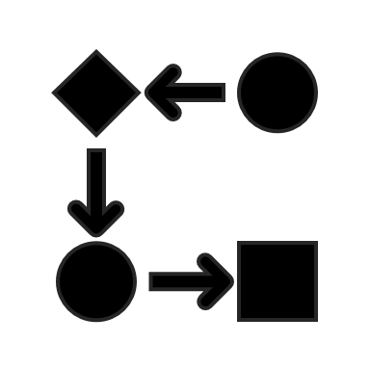



Authoring Components
Category Management: Organizing content into distinct groups for efficient retrieval and management.
Workflow Management: Streamlining and automating the progression of tasks through predefined processes.
Content Type Management: Defining and managing different types of content with specific attributes.
Task & Notification: Assigning and tracking tasks while notifying relevant users about updates or deadlines.
Batch Jobs: Executing repetitive tasks automatically in bulk at scheduled intervals.
Floats: Modularized Content Loading
Data Import: Importing external data into the system for integration and analysis.
Manage Templates: Creating, editing, and organizing templates for standardized document or content creation.
Integrations: Connecting with external systems or services to facilitate data exchange and workflow automation.
Content Lifecycle Management
Customizable Content Structure, User Groups, Tags/Categories
Dynamic Workflows (Serial/Parallel)
Role-Based Content Security
Sends Task Notifications By Email And/Or SMS
Uses Web-Based Content Editor

