Slide 1
Our AI Work

Slide 2
Topics
Introduction to AI and its stages
Current State & Key Players
Gen AI _ Enterprise Business Context
Our AI Innovation for Kapture, Siebel, and more
Next Steps
  AI Services Deck

Slide 3
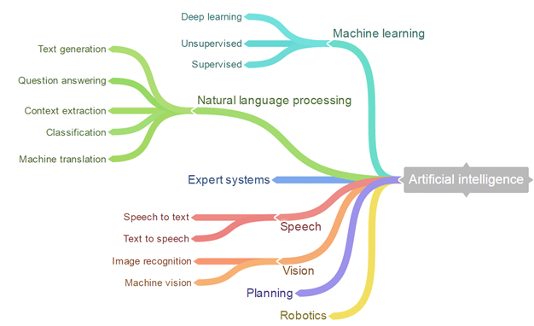
Brief of AI
Notes:
AI is not new. Alan Turing started in 50’s.
Expert Systems in the 80’s
ML in the 90s
Big Data & Deep Learning in 2000s (GPU)

Slide 4
General Introduction
Artificial Intelligence (AI) is a branch of computer science that involves creating machines with human-like thinking and behavior.
Machine Learning(ML), a subfield of AI, allows computers to learn patterns from data and make predictions without explicit programming.
Neural Networks (NNs). a subset of ML, mimic the human brain's structure and are crucial in deep learning algorithms.
Deep Learning (DL), a subset of NN, is effective for complex problem-solving, as seen in image recognition and language translation technologies.
Generative AI (GenAI), a subset of DL, can create diverse content based on learned patterns.
Large Language Models (LLMs), a form of GenAI, specialize in generating human-like text by learning from extensive textual data.

Slide 5

Stages of Artificial Intelligence (AI)
Today 2024
STAGE 1
STAGE 2
STAGE 3
Artificial Narrow Intelligence (ANI)
Artificial General Intelligence (AGI)
Artificial Super Intelligence (ASI)
(Machine Learning)
(Machine Intelligence)
(Machine Consciousness)
Specialize in one area & solves one problem
  Siri
  Alexa
  Cortana
Refers to a system that is as
smart as a human
An intellect that is much smarter than best
human brains in practically every field
Notes:
It's important to recognize that while ANI is currently in use and AGI is a goal for the future, ASI remains a theoretical concept, and its realization, if possible, is far beyond our current capabilities. The field of AI continues to advance, and research is ongoing to push the boundaries of what AI systems can achieve.

Slide 6
Current State & Key Players

Slide 7
Key Players
Open AI
Google AI
Llama
Mistral
Hugging Face

Slide 8
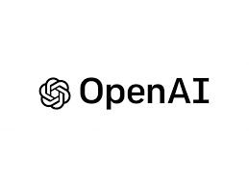
Models
OpenAI Models Variants:
GPT4o ( Size: 3 Trillion Parameters)
  GPT 4.0/ GPT 4.0 Turbo ( Size: 1.75 Trillion Parameters)
  GPT 3.5 ( Size: 350 Billion Parameters)
  GPT 3.0 ( Size: 175 Billion Parameters)
  Embedding Models (text-embedding-ada-002,text-embedding-3-large)
Multiple models, each with different capabilities and price points. Prices can be viewed in units of either per 1M or 1K tokens.
Tokens are pieces of words, where 1,000 tokens is about 750 words.

Slide 9

Models
Google AI Models Variants:
Gemini 1.5 flash – Size: 20 billion Parameters
Gemini 1.5 Pro – Size: 120 billion parameters
Gemini 1.0 Pro –Size: 27 billion parameters
Gemini 1.0 Pro Vision-Size: 27 billion parameters
Gemini 1.0 Ultra- Size-Few Trillion of parameters
Gemini 1.0 Ultra Vision- Size- Few Trillion of parameters
Gemma-Size-2/7 billion parameters
Multiple models, each with different capabilities and price points. Prices can be viewed in units of either per 1M or 1K tokens. Prices are also dependent on Context Window of the model.
Tokens are pieces of words, where 1,000 tokens is about 750 words.

Slide 10
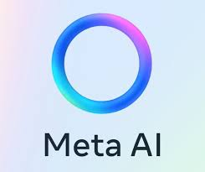
Models
Llama (Large Language Model Meta AI) is a family of autoregressive large language models (LLMs), released by Meta AI starting in February 2023.
It is a collection of foundation language models ranging from 7B to 70B parameters.
Variations:
  Llama 1- Model sizes 7,13,33,65 B Parameters.
  Llama 2 – Model sizes 7,13 and 70 B Parameters.
  Llama 3- Model Sizes 8,70 B Parameters.
Every successive version of Llama models are trained on more data and more fine tuned.
Therefore, every successive version models are more accurate than
previous version.

Slide 11

Models
  Mistral Models are a family of large language models (LLMs) created by Mistral AI .
  These models are known for being efficient and powerful, particularly for their size.
  Two Variations:
    Open-weight models: These are free to use and come under a permissive Apache 2.0 license.
      Mistral 7B: This is the base model with 7 billion parameters.
      Mixtral 8x7B and Mixtral 8x22B: These are Mixture-of-Experts (SMoE) models, a variation on the standard LLM architecture, with 8x7 billion and 8x22 billion parameters respectively.
    Optimized Commercial Models: These are designed for high performance and require a paid license. Examples: Mistral Small, Medium and Large

Slide 12
Gen AI – Enterprise Business Context

Slide 13
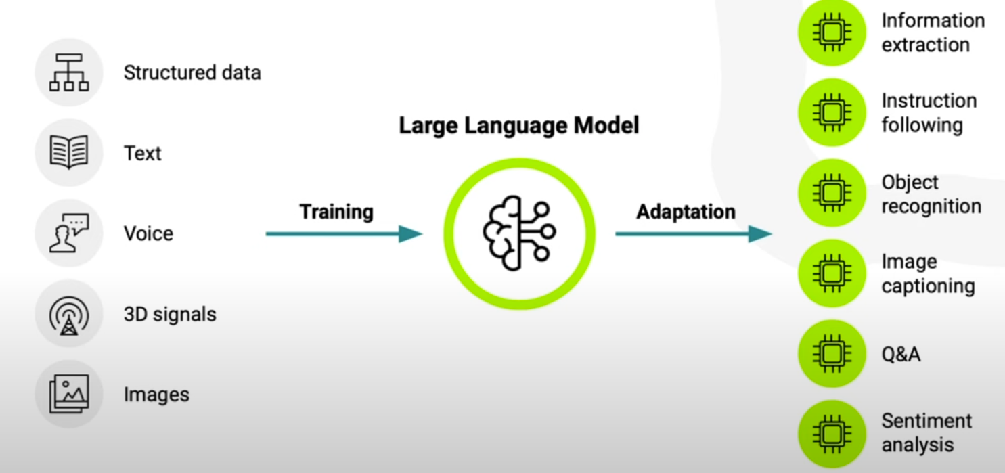
Existing Model for Public Data
Model Selection
Based on specific needs like Text Generation, Text2Text generation tasks.
Consider factors such as model accuracy, size, and resource requirements.
Inference setup
Load the pretrained model or use it through API access.
Configure the model parameters and environment for optimal performance.
Execution
Perform the inference(Ask Question and get the answer)

Slide 14
LLM Models
  Normal LLM models are used for general purpose language understanding and generation (text-generation).
  Chat LLM Models focus on engaging interactive conversation with users. (History is remembered, contextual questions will be answered)
  For Example, following Opensource Models can be used:
    Normal LLM Model: mistralai/Mixtral-8x7B-v0.1
    Chat LLM Model: mistralai/Mixtral-8x7B-Instruct-v0.1, mistralai/Mistral-7B-Instruct-v0.2

Slide 15
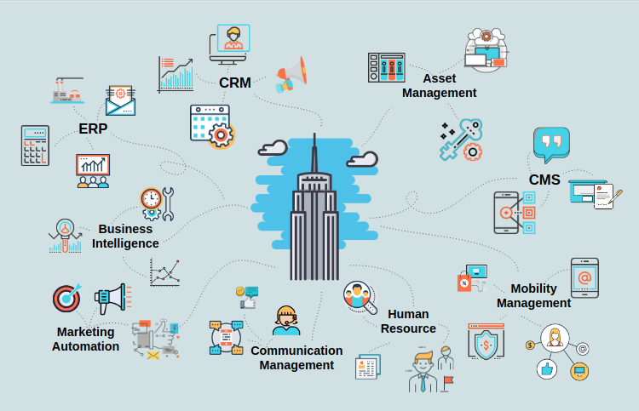
Is this public data Gen AI enough / useful for Enterprises?

Slide 16
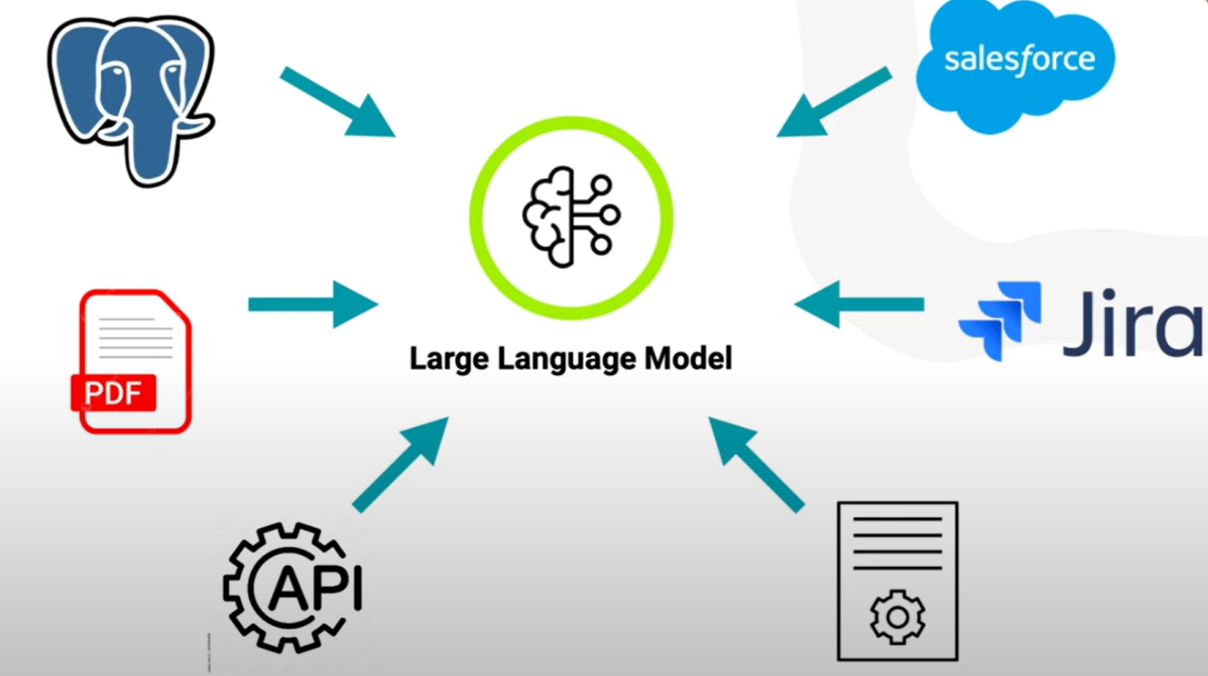
Custom Model for Private Data (LLM + Custom Knowledge)
What they need?
  Identify specific use cases and private data for custom Model.
  Data Collection
  Gather and secure access to private data.
  Ensure data is comprehensive, relevant, and representative of the problem domain.
  Data Preprocessing
  Clean and preprocess the data
  Model Selection
  Based on specific needs like Text Generation, Text2Text generation.
  Consider factors such as model accuracy, size, and resource requirements.
  Perform Retrieval Augmented Generation(RAG),Fine Tuning or Function Calling
  Inference setup
  Load the pretrained model or use it through API access.
  Configure the model parameters and environment for optimal performance.
  Execution
  Perform the inference(Ask Question and get the answer)

Slide 17
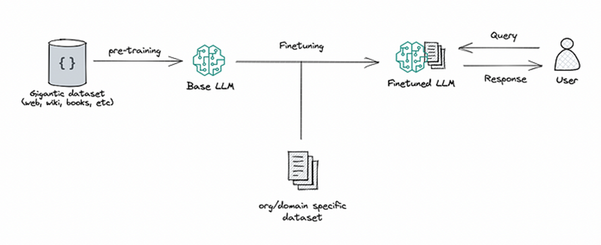
Fine Tuning
For Opensource Models, Base LLM can be loaded on the GPU for Fine Tuning Purpose. Needed proper GPU infrastructure
  Process of taking Pretrained/Base LLM model and fine tuning it’s parameters to dataset relevant to particular task.
  Base LLM is trained on dataset of data relevant to the task.
  Specific for task/domain usually.
  Ample training data is required.
  Can't answers from any new data(Dynamic Data).
  Training takes time and resources like Preparation of dataset,GPU etc.
  Better performance in terms of latency and quality of prediction.

Slide 18
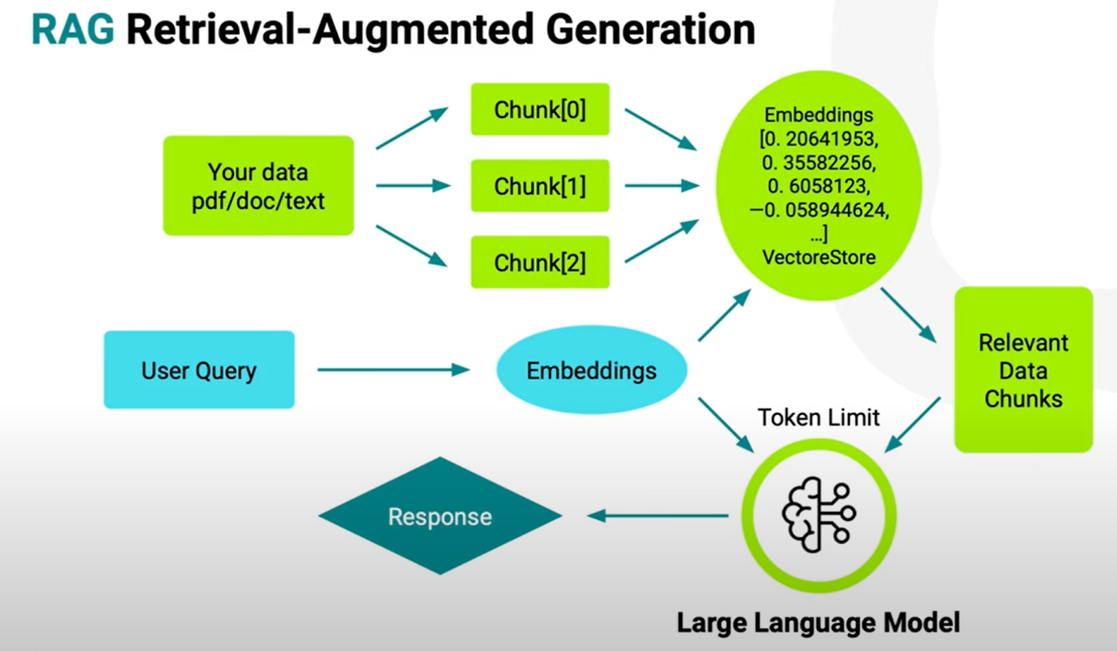
RAG
What to do?
Retrieval Augmented Generation (RAG): is a natural language processing (NLP) technique that combines generative and retrieval-based artificial intelligence (AI) models. RAG can use external knowledge sources to improve the accuracy and reliability of large language models (LLMs).
Implementation Options:
  Option 1: OPEN AI API subscription is required for RAG, Base LLM residing on OPEN AI infrastructure.
  Option 2: For Opensource Models, Base LLM can be loaded on the GPU for RAG Purpose. Needed proper GPU infrastructure.

Slide 19
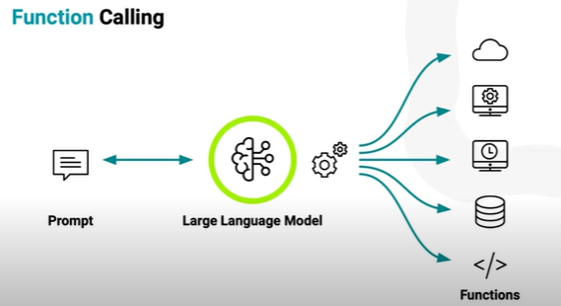
Function Calling
Allows LLM’s to call specific functions during their operation.
Enabling to interact with external systems.
Decision of function calling is based on specific keywords in the query.
For example, if a user asks a sales report., LLM might call function that queries sales database, and the results/latest figures can be integrated into the pipeline.

Slide 20

Our AI Innovations

Slide 22
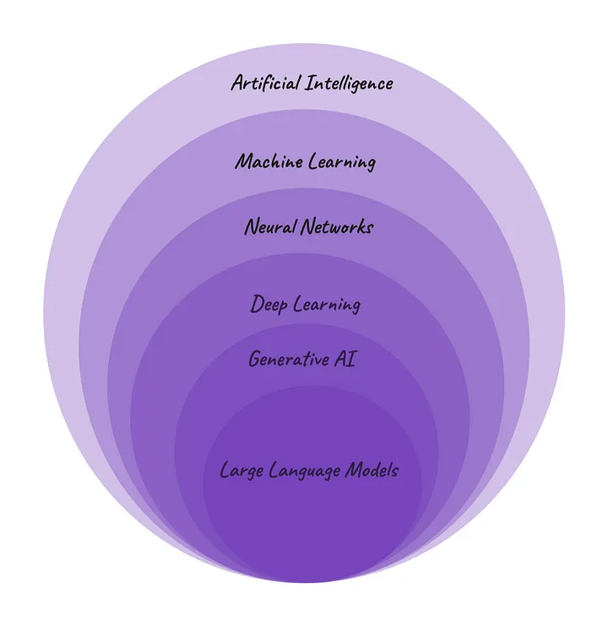
AI : A History and Background

Slide 23
Three Stages of AI
Artificial Narrow Intelligence
Designed and trained to do specific task.
Operate under limited set of constraints.
Example: Image recognition, Natural Language Processing, Recommendation systems, Generative AI
Artificial General Intelligence
Strong AI or Human level AI
Apply intelligence over broad area of tasks, cognitive abilities.
Current status AGI is not achieved. Researchers are working on it.
Artificial superintelligence(ASI)
Systems that surpass cognitive abilities of human.
Exceeds human intelligence in all domains.
Can impose ethical and existential risk.

Slide 24
Generative AI
  Generative AI, or generative artificial intelligence, is a type of AI that can create entirely
  new content, like text, images, music, and even videos.
  Generative AI models are trained on massive amounts of existing data, like books, code, or
  pictures.
  By analyzing this data, the models learn the underlying patterns and relationships.
  Generative AI has numerous applications, including generating realistic images, text
  generation, creating music, designing new products, and even generating synthetic data
  for training other AI models.

Slide 25
Vendor Offerings
  OpenAI offerings
  Paid Subscription to use their latest model GPT4o through Chat Interface.(https://chatgpt.com/)
  Paid subscription to use all GPT models including GPT4o through API ,in our code. (Pricing | OpenAI)
  Opensource Offerings
  Access through Hugging Face Platform.
  https://huggingface.co/
  Access to various models for various tasks like Text Generation, Question Answering, Summarization,
  Text2Text Generation etc.

Slide 26
Retrieval Augmented Generation(RAG)
  No Training is required, and implementation can be immediate.
  No computation cost and less resources are required.
  GPU is required for Opensource Models.
  A common Model ( Base LLM) can be used across different use cases.
  Can answers from any new data(Dynamic Data).

Slide 27
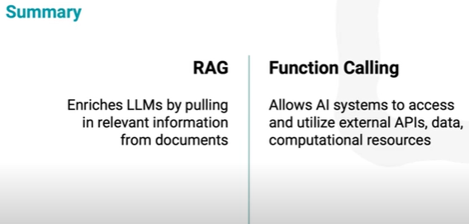
RAG vs Function Calling

Slide 28
  Open-Source Model Exploration
    Fine Tunning for Custom Model.

Slide 29
Steps in Fine Tuning
  Choosing a Fine-tuning task
  Data Preparation
  Select a Base Model
  Fine-tuning job/Actual training the model.
  Model Deployment
  Inferencing.

Slide 30
Fine Tuning Vs RAG. When to use?
  If there are multiple use cases on Q&A specific to different domains, then building different fine-tuned models for each will not be cost effective.
  It will consume more time for preparation of dataset on each domain and then fine tuning those datasets.
  Best Solution→ RAG Architecture for different domain data. This will be implemented fast and cost effective.
  RAG Architecture is best suitable if the data for the system changes/updated frequently.

Slide 31
Analysis
Model | Number of Parameters | Task | Source Company | Repository | Results-Comments
gpt-neo-1.3B | 1.3 B | Text Generation | EleutherAI | Hugging Face | General Question- Ok Math Questions-Wrong Output for complex operation. https://huggingface.co/EleutherAI/gpt-neo-1.3B
MiniChat-1.5-3B | 3 B | Text Generation, Conversational | GeneZC | Hugging Face | General Questions-Ok-No Out of GPU memory. Kapture Data Questions- GPU out of memory , When data is processed by GPU and when results are generated. https://huggingface.co/GeneZC/MiniChat-1.5-3B
t5-small | 60 M | Text2Text Generation, Translation | Google | Hugging Face | General Questions-Not able to answer General Factual Questions. https://huggingface.co/google-t5/t5-small
flan-t5-large | 780 M | Text2Text Generation | Google | Hugging Face | General Questions- Wrong answers Kapture Data Questions ( Tested on Google Colab)- Not able to answer some questions-wrong answers https://huggingface.co/google/flan-t5-large https://huggingface.co/google/flan-t5-base
flan-t5-base | 250 M | Text2Text Generation | Google | Hugging Face

Slide 32
Analysis
Model | Number of Parameters | Task | Source Company | Repository | Results-Comments
Mistral-7B-Instruct-v0.2 | 7B | Text Generation, Conversational | Mistral AI | Hugging Face | General Question- GPU out of memory when , General Question is asked. https://huggingface.co/mistralai/Mistral-7B-Instruct-v0.2 https://mistral.ai/news/announcing-mistral-7b/
Observations/Analysis:
Higher parameter models are having Higher accuracy of results as compared with lower parameters.
If the model is not able to answer General Questions, then answering capability for Custom Data is also less.
OpenAI GPT3.5/GPT4/GPT4o Models are having more than 350B parameters. Therefore, they are well trained already.

Slide 33
Comparison
Attributes | Llama-2-7b-chat-hf | Mistral-7B-Instruct-v0.2 | GPT 3.5 Turbo Instruct
Hugging Face Repository | meta-llama/Llama-2-7b-chat-hf | mistralai/Mistral-7B-Instruct-v0.2 | Not Applicable ( OpenAI Model)
Licensing | llama2 | Apache 2.0 | Free Limited API access on OPENAI Key.
Type of Model | Text Generation, Conversational |  | Text Generation
Deployment and Inferencing | Need High Configuration NVIDIA GPU’s with High Configuration Hardware and Software |  | API Access
Context Window | 4K | 32K | 4K
Size of Model | 7B | 7B | 175B
Massive Multitask Language Understanding(MMLU) | 44.4% | 60.1% | 70%
Natural Questions | 24.7% | 28.8% | 30.2%
TriviaQA | 63.8% | 69.9% | 71.2%

Slide 34
Our Findings( RAG-Opensource Models)
  Mistral-7B-Instruct-v0.2 Model is having higher Context Window(32K) as compared with Llama-2-7b-chat-hf model(4K).
  Due to higher Context Window, Model is having capability to do inferencing on longer text/PDF.
  Using Mistral-7B-Instruct-v0.2 Model , we performed inferencing on 92 pages PDF documents.
  Mistral-7B-Instruct-v0.2 Model performs well as compared with Llama-2-7b-chat-hf model on
  different benchmarks like Massive Multitask Language Understanding (MMLU), Natural Questions
  and TriviaQA Datasets.
  Mistral-7B models outperforms Llama2-13 B and Llama1-34 B on all benchmarks.
  Please refer below link :
  Mistral 7B | Mistral AI | Frontier AI in your hands

Slide 35
AI Innovation in Kapture and Siebel,
Demo

Slide 36
AI Innovation in Kapture
Implemented RAG approach successfully.
Tweaked initially GPT-3.5-Turbo-Instruct model in our code and performed inferencing
Implemented Question-Answering ,step-by step answering ,compound questions use cases.
Tweaked latest GPT-4o model in our code.
Able to perform Inferencing over long documents of any pages.

Slide 37
AI Innovation in Siebel
Able to implement Siebel Gen AI Chatbot over Siebel data.
Siebel chatbot answers following type of questions:
Predictive and Identification Questions
Customer Satisfaction Questions

Slide 38
Next Steps

Slide 39
Which AI Services can be Offered?
  Improve Customer Experience(CX) by defining custom chatbots over 10-K reports. Ability of Chatbot will be:
  Able to extract and Summarize challenges/risk factors faced by the
  company on various areas like Operational, Technological etc.
  Able to provide solutions to overcome the challenges/risk factors
  Able to quickly locate specific financial metrics(revenue/earnings) within
  10-K report.
  Able to Summarize key financial results and trends highlighted in the report.
Natural Language Processing (NLP) Services:
  Transform unstructured text data into actionable intelligence with our advanced NLP
  solutions.
  Predictive Analytics:
  Anticipate future trends and behavior patterns with our predictive analytics solutions, enabling proactive decision-making.

Slide 40
Which AI Services can be Offered?
  AI Consulting :
  Benefit from our expert guidance and strategic insights to maximize the impact of AI on
  your business.
  Custom AI /Model Development:
  Tailor-made AI solutions crafted to meet your unique needs and objectives, ensuring optimal
  performance and scalability.

Slide 41
Technology Stack
At SoftClouds, we utilize a state-of-the-art technology stack comprising cutting-edge tools and frameworks, including but not limited to:
RAG/Fine Tuning techniques
Custom Model Development
Vector Databases: Opensource Vector DB like Llama Index, Chroma, Pinecone, Milvus, FAISS can be used.
  Embedding Models: HuggingFaceEmbeddings, BERT/ DPR T5 Embeddings
  Transformer) Embeddings.
  Retrieval Engine: Retrieving relevant documents from Vector DB relevant to query. For example, FAISS
TensorFlow
PyTorch
Model Deployment

Slide 42
Enablement Options for Enterprises
  Option 1: OpenAI API subscription plan
  Purchasing plan for GPT models
  Get paid OPEN AI Key from OPEN AI
  Plug in the key in our current software deployment
  Start performing Inferencing/Question-Answering services/Chat Services.
  Option 2: Configuring our own GPU over Cloud
  Opensource Model provided under Apache 2.0 License.
  Available under Hugging Face Repository.
  Download the model in our High Configuration System ( GPU’s, Memory, Hard Disk).
  Perform Operation of either Retrieval augmented Generation(RAG) or Finetune the
  model based on Enterprise Data Changes.
  Start performing Inferencing/Question-Answering services/Chat Services.

Slide 43
Future Roadmap
Looking ahead, we are excited to continue pushing the boundaries of AI innovation. Our future roadmap includes the development of new AI-driven products and services aimed at addressing emerging market trends and evolving customer needs.

Slide 44
For Focus Group for AI Services

